Slide 1
Eldoria

Slide 2
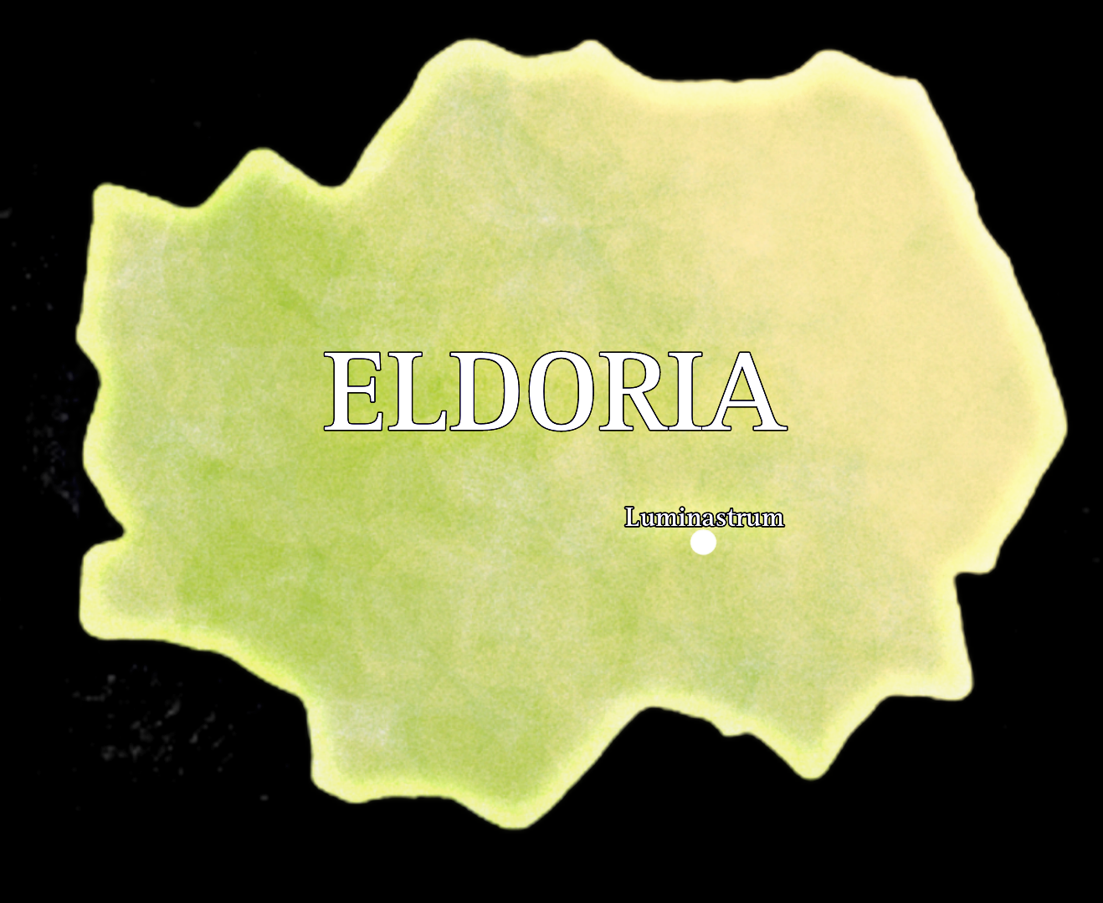
Eldoria
The name means wisdom and knowledge
All the people in Eldoria are well educated and smart
They all accept and support each-other
They help everyone who needs help
Therefor they are a very good comunity
They don´t lie to one another
Has 100 mil. People
Located in south Europe

Slide 3
Laws
Don´t steal
1
Don´t kill
2
Don´t lie
3

Slide 4
Technological level
All the people are well educated, so they created very advanced infrastructure
Most modern country in the world
They use only sustainable and eco energy because they want their kids to survive
They do not have cash, they use non contact payment

